Slide 1
Assessing Data Maturity at Scale
Introduction to Cohort Assessments
Sian Basker, Co Chief Executive
@Data_Orchard @sianbasker
info@dataorchard.org.uk
www.dataorchard.org.uk
Notes:
Welcome, thank you joining us.
Those don’t know us:
DO soc ent specialises helping orgs get better with data.
Work entirely not-for-profit sector – charities, social enterprises, housing providers, and public sector.
Hoping you’re here coz your org
focused building capabilities/advancing collective cause of multiple not-for-profit sector orgs.
i.e. groups of organisations with shared purposes (+ challenges) around data,
Delighted see attendees list people joining us today:
Membership bodies, federations, networks and infrastructure/umbrella orgs
Working local, national and international contexts
Been researching organisational data maturity in 2015. In 2019 created enable organisations:
self-assess how doing with data,
see how compare others,
and identify where focus improve.
Delighted our assessment tool now been used by thousands of people from many hundreds of organisations.
Last 18 months been testing tool with cohorts
v excited ‘bout potential for impact at scale….
=why invite u here today.
Talk ‘bout 5 things today
What our DMA tool is and how can be used at scale with multiple organisations and cohorts
How customisation and benchmarking features can be tailored to your context
About resources available to encourage engagement
How you can build on the assessment to develop communities of practice in your field, and advance and evidence progress
Benefits and rewards of data maturity, both at an individual organisation level and strategic/collective level
Before start think it would be helpful to set out some definitions
(Apologies if you’ve heard these before – know some attended other events):
NEXT SLIDE

Slide 2
What is data maturity?
An organisation’s journey towards improvement and increased capability in using data
What do we mean by data?
When we say 'data' we have a broad definition. We include all the types of information an organisation collects, stores, analyses, and uses. It can be recorded in many formats: numbers, words, images, video, maps.
Notes:
Define Data Maturity –
journey towards improvement + increased capability using data.
2) When say Data – holistic view - ALL of it.
Yes all of it!
Not just numeric data: text, images, videos, maps….
all of it - in messy complexity in every dept, service, job role…
all over your members’ organisations
i.e. everywhere
why simple framework REALLY helpful give structure how people think ‘bout it.
3) While topic definitions:
Going 2 use ‘MEMBERS’ throughout to describe the organisations in your network/cohorts/federations/sub-sectors
NEXT SLIDE

Slide 3
Notes:
The Data Maturity Framework/model
Aims to engage, be accessible and understandable to everyone in the organisation
notably mostly non-technical/non-data people
Breaks it down 5 stages – unaware – mastering
7 key themes (factors) that are crucial to advancing data maturity journey.
2 are obvs – Data and Tools (to collect, store and analyse)
2 are about purpose – how you USE it , how you analyse
3 are about people – skills, leadership and culture
INSERT NEW SLIDE FROM END HERE
You may have seen our ‘SOS report? (Next annual publication due imminently!
Overall – not very data mature.
Hardly any operating at mastery/forefront.
Most are learning,
One in five are really lagging behind
One in three are really working to develop …
and it’s hard and they could all do with some help and support
NEXT SLIDE

Slide 4
About the data maturity assessment
Notes:
Assessment involves staff taking an online questionnaire designed around each of the themes and sub-themes
e.g. Leadership – questions around subthemes:
attitudes, planning, capability, investment.
Takes around 20 minutes.
NEXT SLIDE

Slide 5
Notes:
Taking a data maturity assessment is great because:
i) Learning
Answering questions gets you thinking.
ii) Measuring
I’ll show example of report in a moment
iii) Inspiring people, generating ideas, motivating to improve
WHEN SCALE UP TO ORGANISATION LEVEL….
(NEXT SLIDE)

Slide 6
Notes:
As said earlier – data maturity is founded on people. Without the leadership, culture and skills of the people your organisation get better.
Our DM assessment is really about engaging LOTS of people – sometimes everyone!
Start of a journey
Second key impact is that it’s a catalyst for action
i.e. it leads on to plans and investment of resources to improveWhen you engage people in this process it builds their understanding about data, and motivates them to help the organisation improve.
Good time to introduce our theory of change
(NEXT SLIDE)

Slide 7
Data Orchard’s Theory of Change for Data Maturity
Notes:
Mentioned earlier Data Maturity Assessment is about a journey
This is the theory of change for data maturity
Tested and we have good evidence to support this.
(What out for forthcoming impact report later this week!)
Imagine this happening at scale!

Slide 8
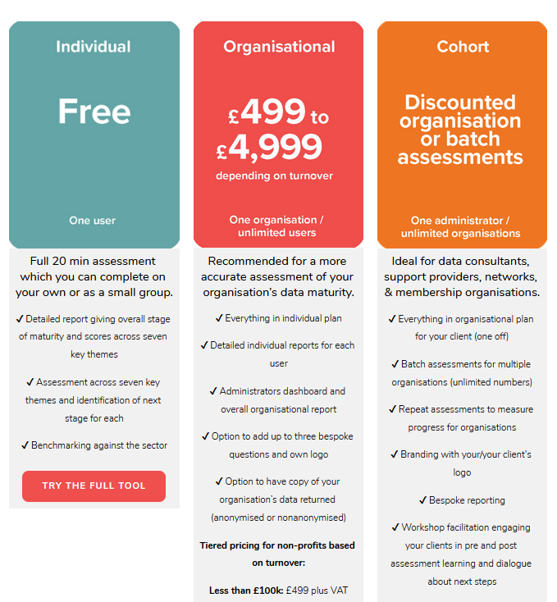
Notes:
These are our three assessment products
Single User (free)
Ideal if really small org (many are) –
do it together small grp/take separately.
ii) Organisational – Multiple Users (£500 - £5k)
Ideally suited: larger, more dispersed/complex orgs
Designed 4 multiple people to take.
Unlimited indiv reports + one overarching whole org report
Customisable
iii) Cohort – Multiple organisations
Talk today about batch/cohort assessments aimed at infrastructure/networks/membership orgs i.e. your orgs!
NEXT SLIDE

Slide 9
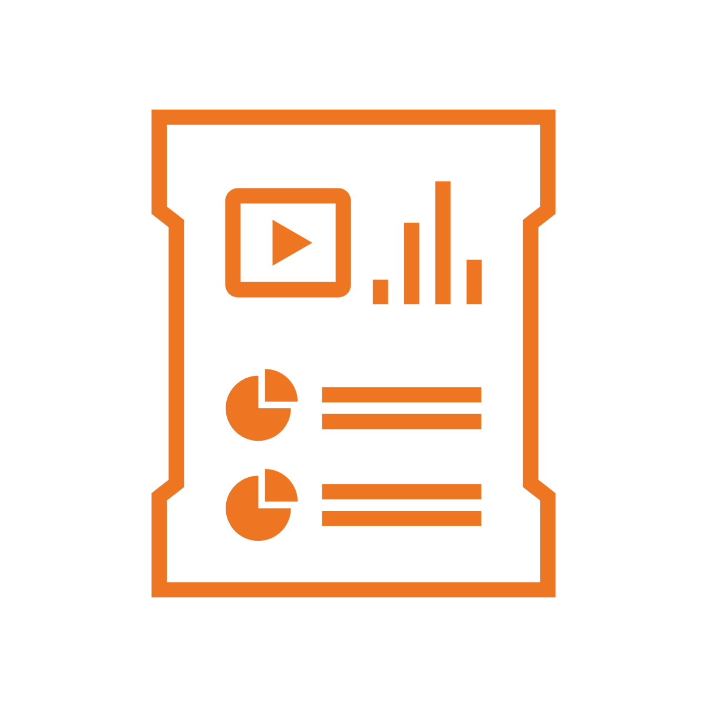
Individual Free Assessment
Cohort Assessment
One user takes an assessment, receives a self assessment report and takes action
Organisation Assessment
Cohort lead sees all cohort organisations’ reports and gets a customised cohort report
Whole organisation assessments are undertaken by multiple people in multiple organisations
A super user in each organisation has an aggregated dashboard for their organisation
Each user takes an assessment and receives a self assessment report
A super user sees an aggregated dashboard combining all users’ results.
Whole organisation takes action
Notes:
MULTIPLE ORGANISATIONS TAKES ACTION! – AND HELP EACH OTHER ALONG THE WAY
YOU TAKE ACTION TO SUPPORT THEM AT SCALE

Slide 10
Customisation for networks/memberships
Create your own sign up pages with custom questions
Brand to your network (and/or cohort members)
Resource pack
Unique links for your members
sign up page
individual reports for each user (unlimited)
organisation reports for each member
data download
Notes:
Sign up page + extra questions
Individual branded self-assessment reports for each staff respondent (unlimited)
Org report - Customised dashboard, monitor no of respondents, + combined responses from multiple people (more accurate)
Copy of response data returned (anonymised on non-anonymized)

Slide 11
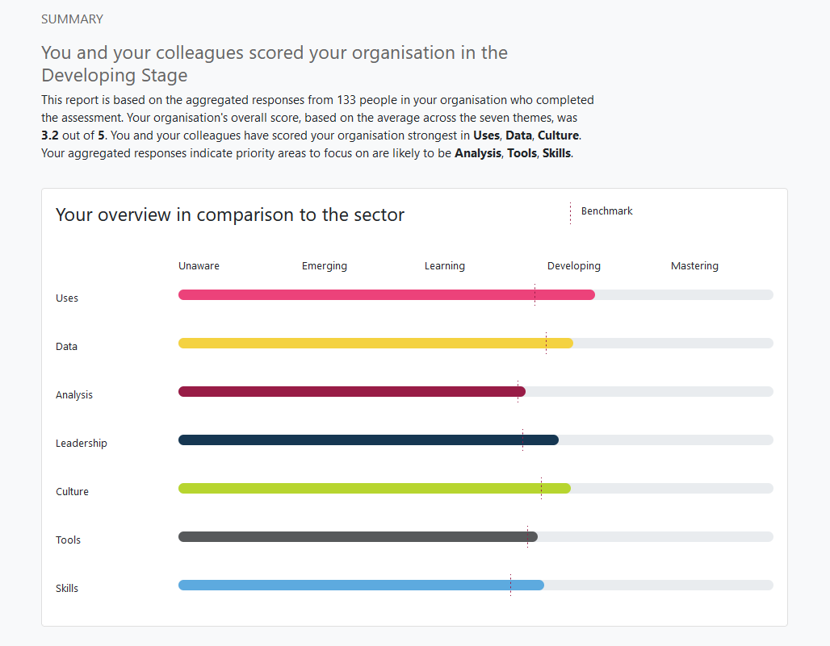
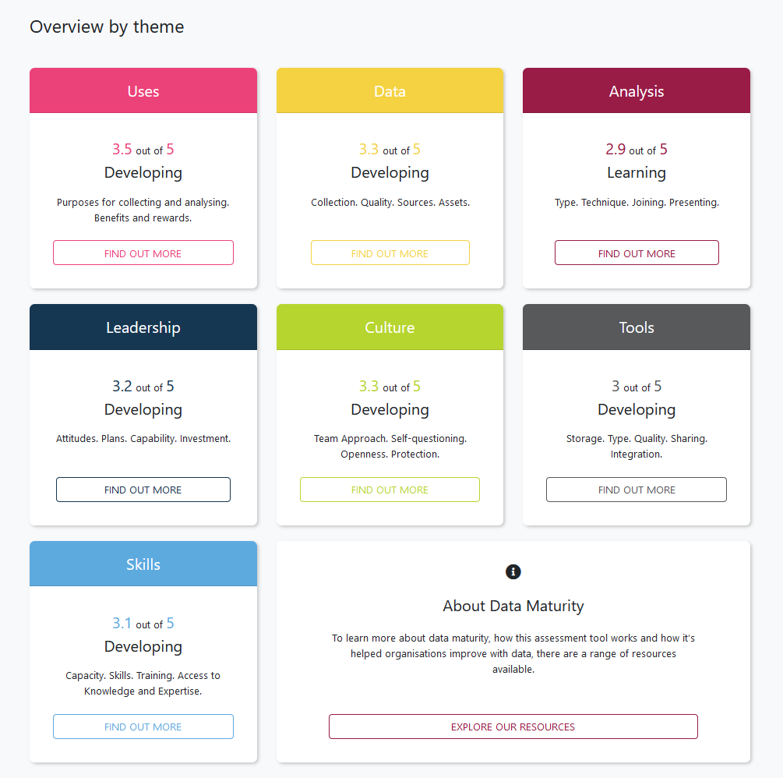
Notes:
Combined reports
More sophisticated in how they are scored (i.e. don’t know responses)
Assume not everyone knows everything.
Give a more accurate picture of where the organisation is
REPORTS FOR EACH MEMBER WILL INDICATE
i) How many completers
ii) Where org is overall on (on 5 stage journey): Unaware, Emerging, Learning, Developing or Mastering;
iii) How organisation scored itself across the seven themes: Uses, Data, Analysis, Leadership, Culture, Tools and Skills
iv) Where your org strengths are
v) ~three priority areas to focus on to improve

Slide 12
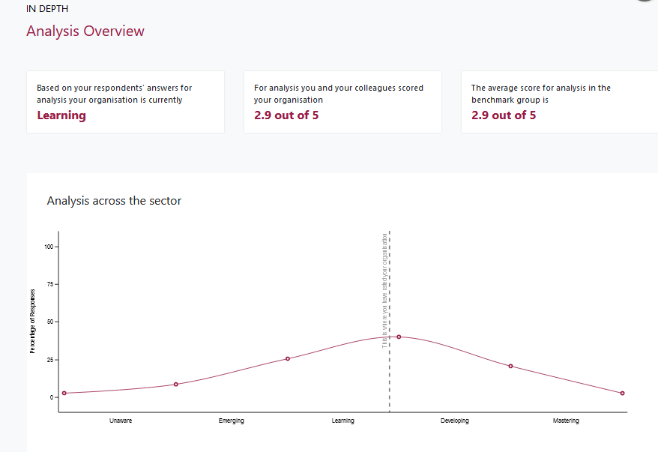
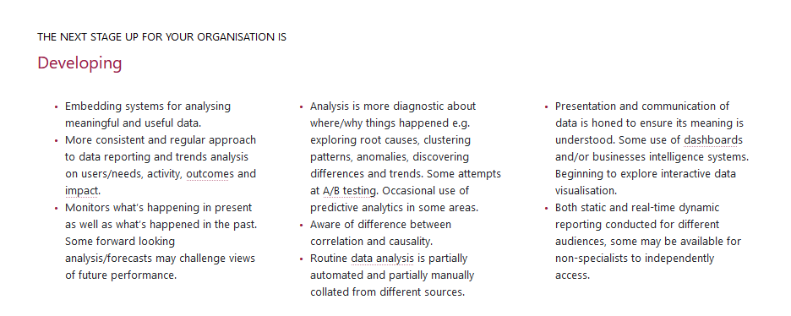
Notes:
Your org score
Average score in benchmark
Description where now – where next

Slide 13
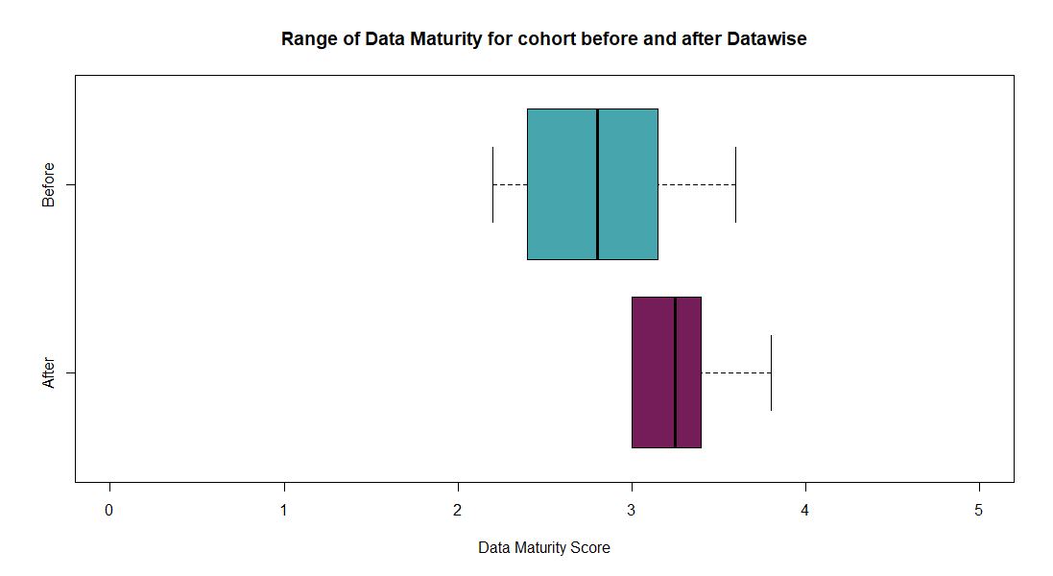
Example of cohort benchmarking – Datawise London
Notes:
Use example Datawise London – group of 7 organisations cohort assess
Boxplot – showing range of scores from organisations before and after support.
Seven in baseline assessment – (actually not dissimilar to SoS)
Overall shift – 10 months
Repeat assessments can demonstrate progress over time…and potentially the impact of interventions.
Right now Datawise London are conduct a third Data Maturity Assessment with the same cohort

Slide 14
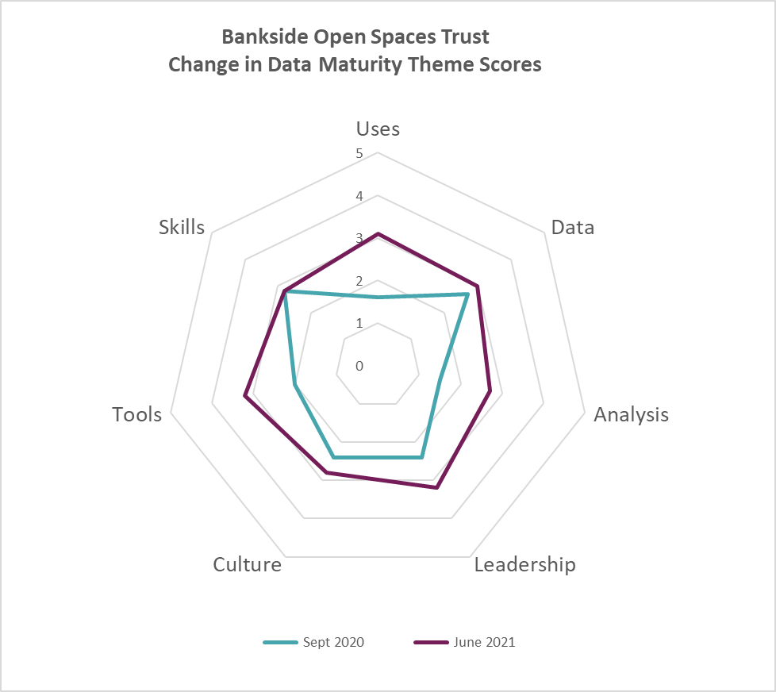
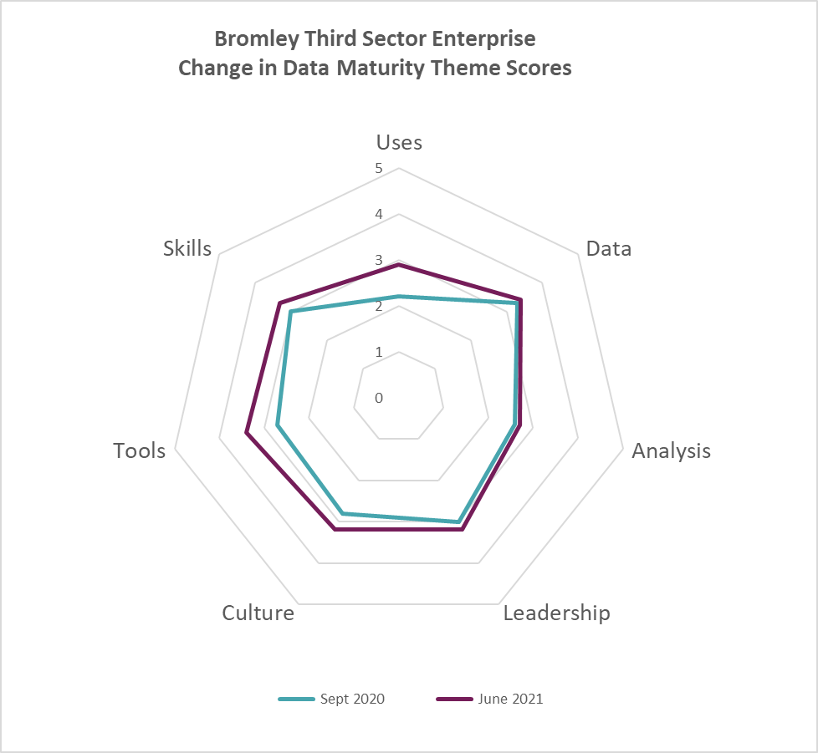
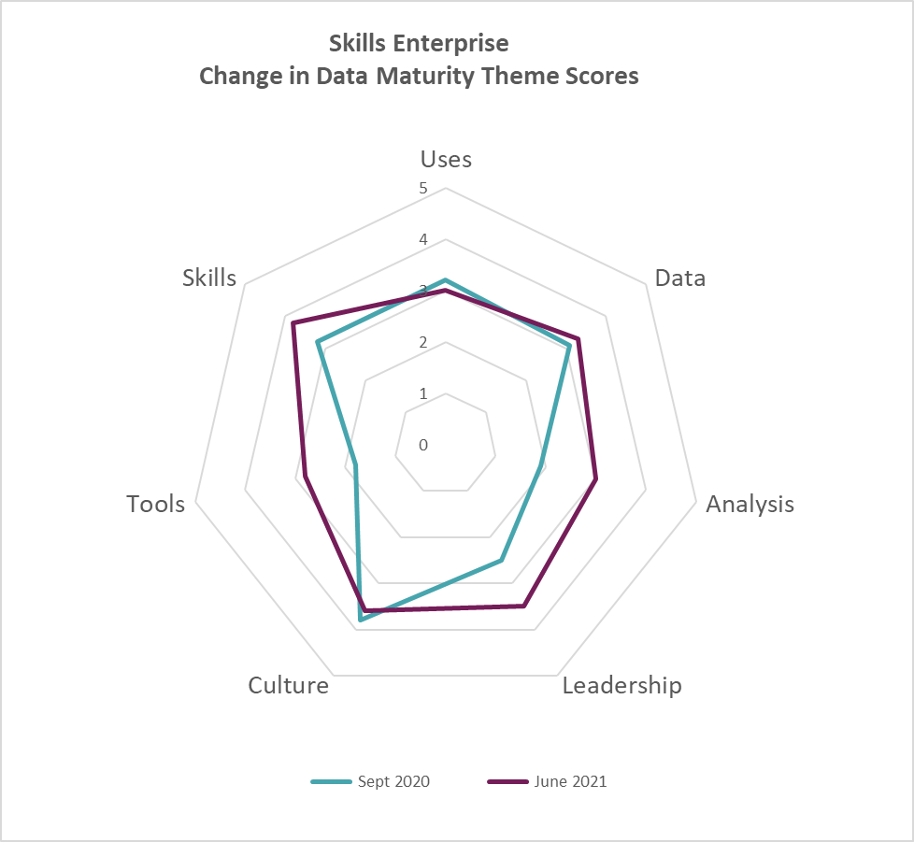
Examples of change in data maturity theme scores for individual organisations
This organisation
That organisation
Another organisation
Notes:
These charts show different baseline scores (in blue) for each of the seven themes for 3 different organisations –
Different starting points are all different and the areas they make progress in are all different.
These charts demonstrate that it’s not linear and, depending on where you focus your efforts/goals for improvement will reflect different degrees of progress in different areas.
Stories/journeys and impacts are all different

Slide 15
Immediate benefits
To you
To your members
Independent diagnostic
Comparisons via benchmarks
Identify problems and needs
Evidence to support funding
Baseline established
Engagement
Learning
Leaders and pioneers
Motivation
Feel supported
Notes:
Consistent, robustly researched + indep tool diagnose members’ needs – within established framework
ii) Compare your members – places your cohort within wider context of data maturity in the sector (and with sector benchmarks – potential for customised benchmarking)
iii) Help you work out where your members most need support
iv) Evidence to support funding for building data capabilities
v) Baseline for measuring your impact
YOUR MEMBERS:
Accessible way of engaging members (and their staff) in learning about data.
Improved understanding about data within the membership
Context relevant leaders/pioneers identified
Increased motivation and inspiration to improve
Feel supported in their needs (elephant in the room

Slide 16
Long term potential benefits
Strategic approach
Economies of scale
Peer Learning
Accelerated data maturity
Notes:
Strategic approach to advancing the data capabilities of your membership
Not just in assessment but also in planning interventions that could benefit multiple organisations rather than each of them finding their own way
Opportunity to build your own community of data people in your sector. Most charities are small, many don’t have a dedicated data person, even less so a data team… None the less there are skills needs/responsibilities for all
Leaders and laggers – it’s a long journey –typically 8-10 years! Too long…those at forefront can share learning/pitfalls/good practice. Infrastructure organisations need to design programmes to support the sector harness the value…

Slide 17
How we can help you and your members
Free
Individual
Discounted
Organisational
Special
Cohort Assessment
Offer customised organisational Data Maturity Assessments to your members
10% re-seller discount for not-for-profits
Book a call
dataorchard.org.uk/agency
Negotiable package pricing for cohorts of members
Book a call
dataorchard.org.uk/cohort
Share our free Data Maturity Assessment tool with your
not-for-profit members
Try it here
dataorchard.org.uk/dma
Notes:
I’d like to finish with the practicalities
i) Free for you to use with not-for-profit organisations right now for free
Have a button to our free DMA tool on your website (if you’re a non-profit working with non-profits).
ii) Discounted Organisation
We’re offering partners in the not-for-profit sector 10% discount on our prices (range by turnover from £500 to £5000 = vat)
iii) Special Cohort Assesment
Bespoke report.
Multiple assessments.
(you can get a feel for the kind of report we produce by looking at our SOS report)

Slide 18
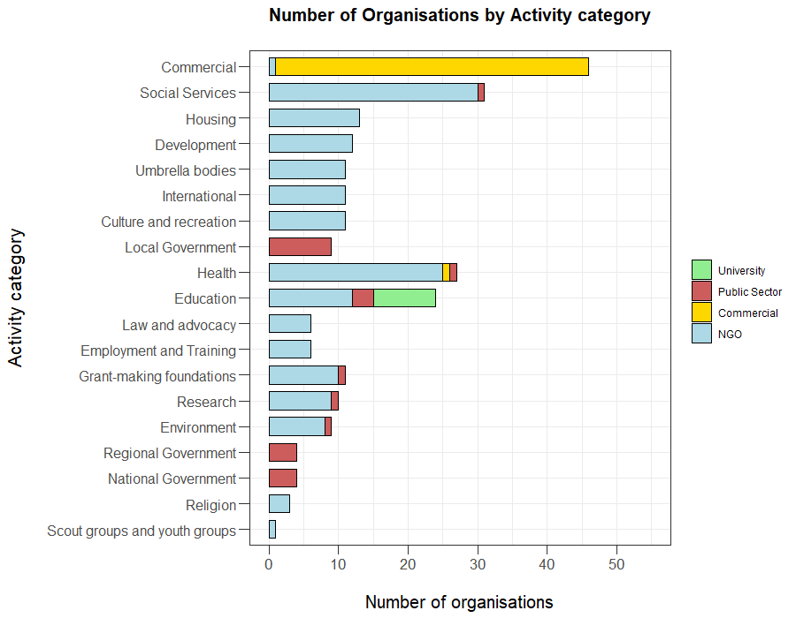
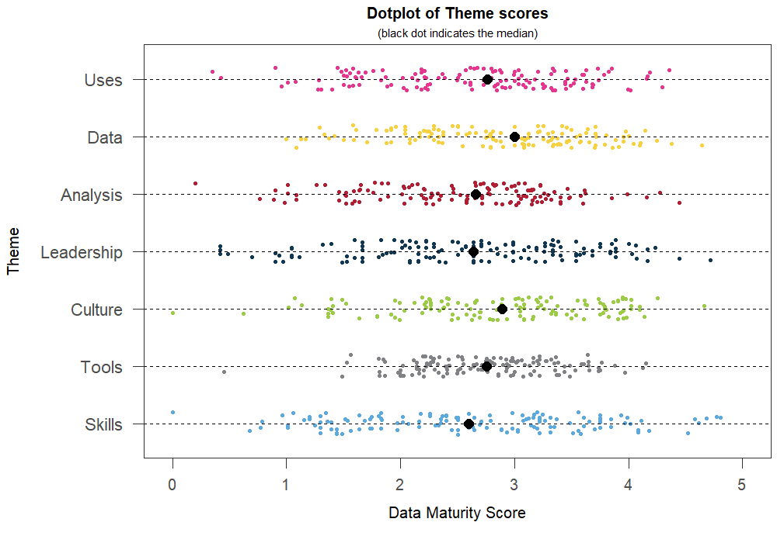
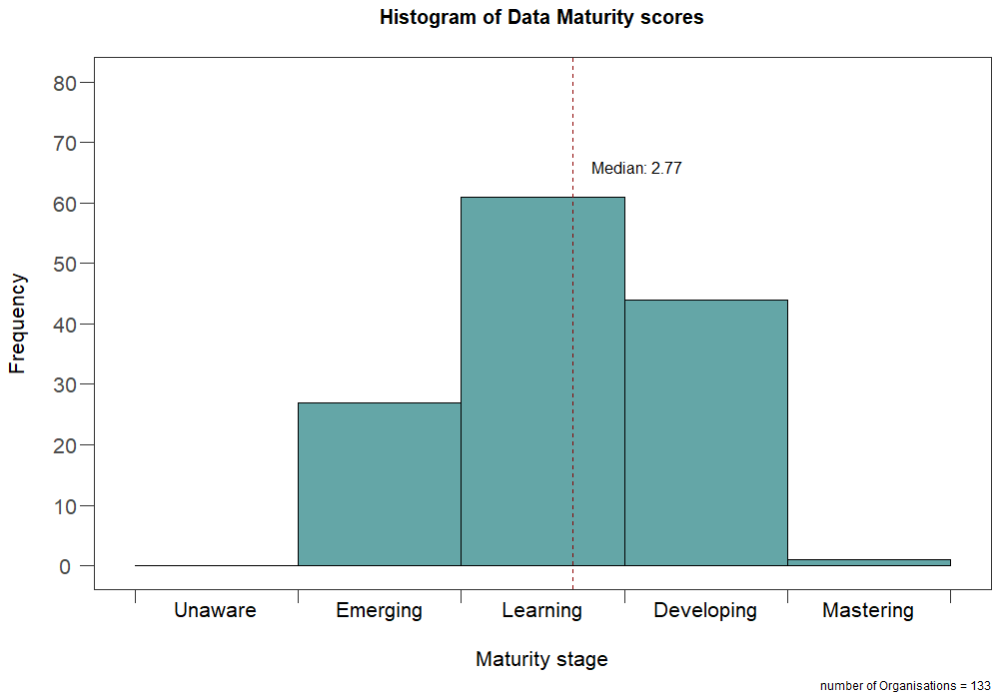
Notes:
Briefly mention SoS headlines:
Tool is used by: All kinds of orgs/all sizes/all over UK and internationally too.
Huge amount of resource goes in (ave 40-50% staff time) – much of it wasted.
Relatively few reaping rewards
They’re all different – strengths and weaknesses
BUT overridingly:
Lack of skills, support and responsibility around data…
Only 31% access to advice and support from experts they trust
They NEED help on this stuff….maybe YOU can do something to support them?
Delighted to hand over to Shona Nichol who’s going to talk about exactly that in the Scottish Government context

