Slide 1
Data Maturity in the Scottish Public Sector
Shona Nicol
Shona.nicol@gov.scot

Slide 2
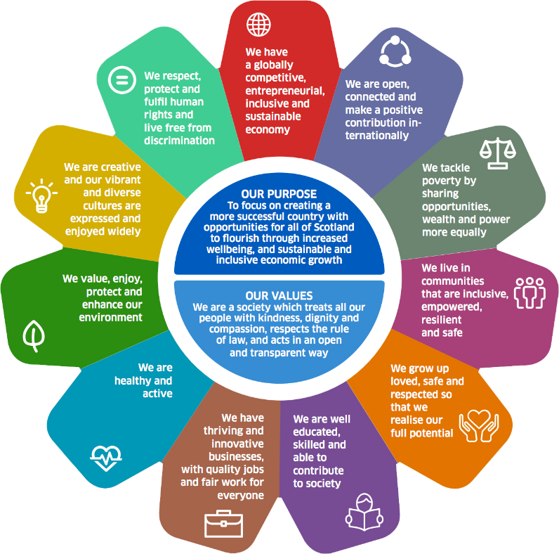
Vision for Data
Data is systematically used to improve decision making: saving time, money and lives

Slide 3
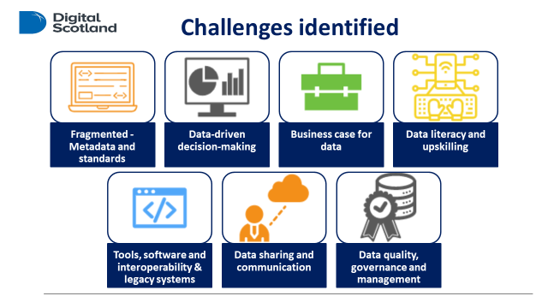

Slide 4
Investing in Data

Slide 5
Data Transformation Framework
Help organisations achieve data improvements and become data fluent – setting out what good data looks like. It will be:
User led
Responsive, flexible, living
User persona approach
Practical, achievable and actionable steps for organisations

Slide 6
Data Transformation Framework
Diagnosis
Enable data maturity assessments
Collaboration
Collaborate with the expert data community and promote good practice and innovation
Knowledge Base
Co-design and develop a knowledge base
Pathways
Customised maturity pathways to guide organisations on their data improvement journeys

Slide 7
Data Maturity

Slide 8
Data Maturity Programme
To support a cohort of public sector organisations to:
undertake a data maturity assessment;
develop an action plan to pursue greater data maturity;
take their first steps in implementation; and
do all of this in 6 months!
To use the lessons learned to develop key elements of the Data Transformation Framework

Slide 9
Data Maturity Process
Preparing for assessment:
pilot the process, communicate with staff (both leaders and workforce)
Comms plan, newsletter, guidance, customised sign up page
During and after assessment:
Monitor responses via dashboard
Results for cohort members and anonymised for SG, plus final report

Slide 10
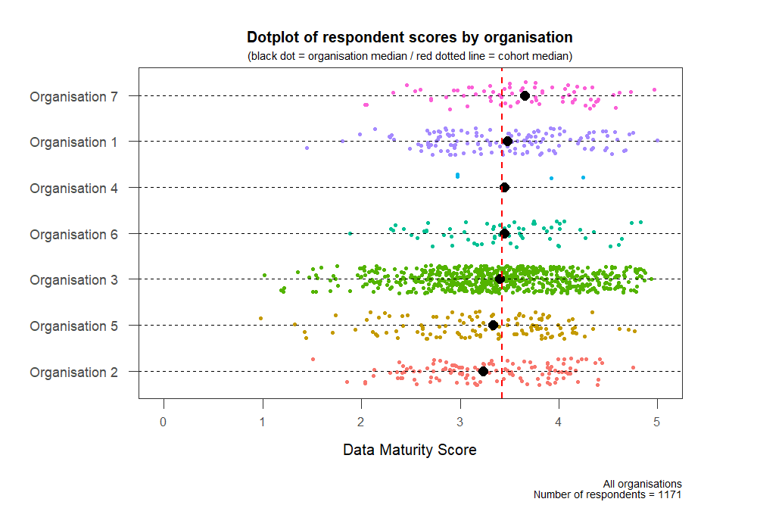
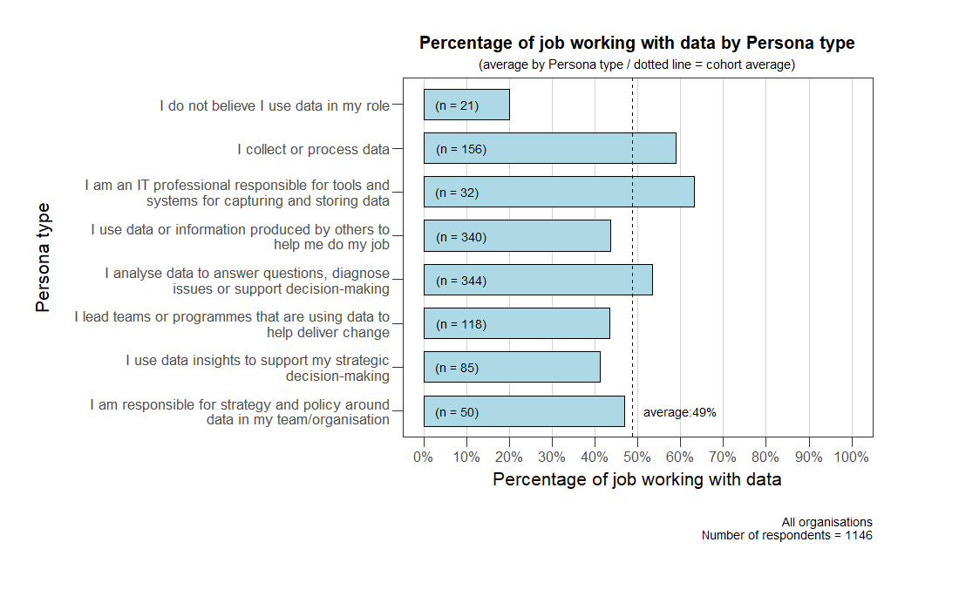

Slide 11
Data Maturity Learnings
Assessments are more valuable that simply the score alone
Preparation can help leadership and workforce buy-in around data maturity
The opportunities for data maturity and the areas of need can feel limitless, a data maturity assessment can help to prioritise

Slide 12
Next Steps
Running another cohort programme later in the summer – 10 organisations this time round
Based on learning for the first cohort – amend the design and move key phases around
Working on a user personas project to help develop the Framework

Slide 13
Q&A
Shona Nicol
Shona.nicol@gov.scot

